Slide 1
Crisis: the juncture of stability and development
William O’Toole
Events Development Specialist
Risk as an opportunity

Slide 2
Key points: Snapshot or longitudinal view
Most mega and major events have grown incrementally. They started small. The unsuccessful have disappeared, new events are started and the successful have adapted. This churn over time is vital to the health of the events sector.
Standard Crisis response: Recovery and return to normal.
Maturity Model view: Crisis as an agent of change.
Disruption moves the sector along a maturity path.
Example: Terrorism crisis and resulting legislation moves all events into the need for standards.
Mandatory standards are risk averse and reflect the bureaucratic response of shifting risk.
Unintended consequence are:
Sudden and large cost to current small events, cancellations.
Entry cost: A new barrier to entry for nascent events.
Focus on existing major and mega events.

Slide 3
Problem/Solution
Internal contradictions :
Stasis: No new events to grow incrementally and ‘organically’ i.e. no ‘churn’.
Event portfolios become the same worldwide, stale and economically unsustainable without major government funding.
Solution
Dubai/Edinburgh/New Zealand – strategies call for new ideas
Events Strategy must understand the longitudinal view, that today’s events will become moribund.
There is need for innovation, incubation and a diversity of events to compete.
Crisis?
Presents an opportunity for development.

Slide 4
Event maturity table
On an International level this becomes………

Slide 5
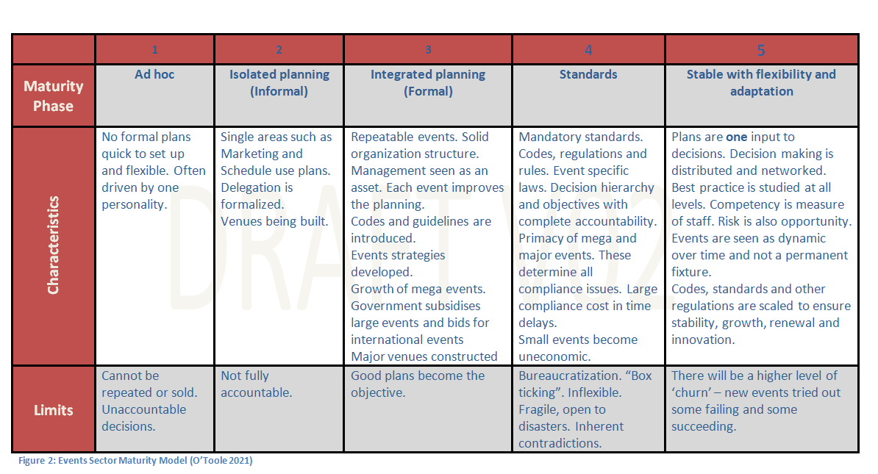
Events Sector Maturity Model

Slide 6
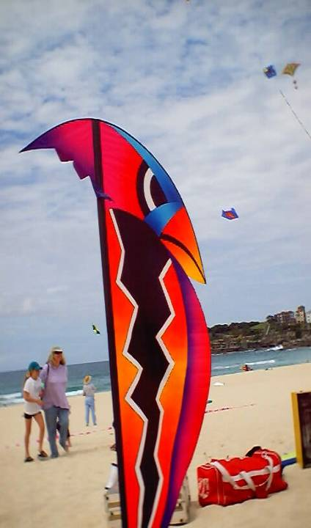
Example: Festival of the Winds: September each year
Ad Hoc: single person and kite flying friends
Isolated Planning: need for some plans e.g. marketing for sponsors
Integrated Planning: Local Council requirements and risk management needed
Standards: ISO31000, OHS, Terrorism, Public Health
TIME
TIME

Slide 7
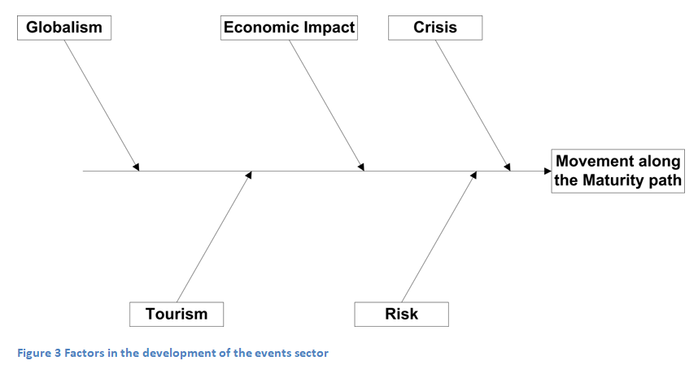
Driving the development
Five factors driving events into the Standards phase. All have to do with the success of the events sector around the world

Slide 8
Crisis = complexity + fragile + disruption risk + innovation= Opportunity
“Normal” in a complex system over time is not a static state. It is dynamic and, in the case of the event sector, moves through phases determined by self organization and survival combined with the globalization of the sector.
Crisis is a disruption that opens many opportunities. It breaks the dominance the past mega events have in the sector. They are slow moving, exposed to crisis and hence, fragile.
The crisis may allow the more agile and creative events and event teams an inflexion point to move the sector into an innovative phase with wide diversity of unique events.
In this phase the risk management is also used as the management of opportunities.

Slide 9
More information
An example of the country wide application of the Maturity Model and events development.
Festival of the Winds: https://www.festivalofthewinds.com.au/
O’Toole, W. (2018). Safe and Healthy Crowded Places Handbook 15. Australian Institute for Disaster Resilience, www.aidr.org.au

